Slide 1
C++ Plus Data Structures
Nell Dale
David Teague
Chapter 9
Trees Plus

Slide 2
A Binary Expression Tree
How to evaluate this?
( 4 + 2 ) * 3
‘*’
‘+’
‘3’
‘4’
‘2’
What value does it have?
( 4 + 2 ) * 3 = 18

Slide 3
A Binary Expression Tree is . . .
A special kind of binary tree in which:
1. Each leaf node contains a single operand,
2. Each nonleaf node contains a single binary operator, and
3. The left and right subtrees of an operator node represent subexpressions that must be evaluated before applying the operator at the root of the subtree.
Notes:
“y = (x1*x2+x3)*x4+4” 와 같이 binary operator와 operand로 구성된 expression을 표현하는 binary Tree
각 Leaf에는 하나의 operand를 갖는다.
각 nonleaf node에는 하나의 binary operator가 저장된다.
Operator의 좌우 subtree는 그 operator를 적용하기 전에 먼저 평가되어야 한다. 즉 좌우 subtree의 평가결과는 root에 있는 operator의 operand가 된다.

Slide 4
Levels Indicate Precedence
When a binary expression tree is used to represent an expression, the levels of the nodes in the tree indicate their relative precedence of evaluation.
Operations at higher levels of the tree are evaluated later than those below them. The operation at the root is always the last operation performed.
Notes:
Binary Expression tree를 사용하여 수식을 표현할 때, tree의 level은 수식계산에서 상대적인 우선순위를 나타낸다.
높은 레벨의 연산들이 나중에 수행된다. 따라서 root에 있는 연산은 항상 마지막에 수행된다.

Slide 5
A Two-Level Binary Expression
treePtr
‘-’
‘8’
‘5’
INORDER TRAVERSAL: 8 - 5 has value 3
PREORDER TRAVERSAL: - 8 5
POSTORDER TRAVERSAL: 8 5 -

Slide 6
Inorder Traversal: (A + H) / (M - Y)
Print second
tree
‘/’
‘+’
‘-’
‘A’
‘H’
‘M’
‘Y’
Print left subtree first
Print right subtree last

Slide 7
Preorder Traversal: / + A H - M Y
Print first
tree
‘/’
‘+’
‘-’
‘A’
‘H’
‘M’
‘Y’
Print left subtree second
Print right subtree last

Slide 8
Postorder Traversal: A H + M Y - /
Print last
tree
‘/’
‘+’
‘-’
‘A’
‘H’
‘M’
‘Y’
Print left subtree first
Print right subtree second

Slide 9
Evaluate this binary expression tree
( 8 - 5 ) * ( 4 + 2 ) / 3
‘*’
‘-’
‘/’
‘8’
‘5’
‘+’
‘3’
‘4’
‘2’
What infix, prefix, postfix expressions does it represent?

Slide 10
A binary expression tree
‘*’
‘-’
‘/’
‘8’
‘5’
‘+’
‘3’
‘4’
‘2’
Infix: ( ( 8 - 5 ) * ( ( 4 + 2 ) / 3 ) )
Prefix: * - 8 5 / + 4 2 3
Postfix: 8 5 - 4 2 + 3 / * has operators in order used

Slide 11
InfoNode has 2 forms
enum OpType { OPERATOR, OPERAND } ;
struct InfoNode
{
OpType whichType;
union // ANONYMOUS union
{
char operation ;
int operand ;
}
};
OPERATOR ‘+’
OPERAND 7
. whichType . operation
. whichType . operand

Slide 12
Each node contains two pointers
struct TreeNode
{
InfoNode info ; // Data member
TreeNode* left ; // Pointer to left child
TreeNode* right ; // Pointer to right child
};
NULL 6000
OPERAND 7
. whichType . operand
. left . info . right

Slide 13
int Eval ( TreeNode* ptr )
// Pre: ptr is a pointer to a binary expression tree.
// Post: Function value = the value of the expression represented
// by the binary tree pointed to by ptr.
{ switch ( ptr->info.whichType )
{
case OPERAND : return ptr->info.operand ;
case OPERATOR :
switch ( tree->info.operation )
{
case ‘+’ : return ( Eval ( ptr->left ) + Eval ( ptr->right ) ) ;
case ‘-’ : return ( Eval ( ptr->left ) - Eval ( ptr->right ) ) ;
case ‘*’ : return ( Eval ( ptr->left ) * Eval ( ptr->right ) ) ;
case ‘/’ : return ( Eval ( ptr->left ) / Eval ( ptr->right ) ) ;
}
}
}
13

Slide 14
class ExprTree
ExprTree
‘*’
~ExprTree
private:
root
‘+’
‘3’
Build
Evaluate
.
.
.
‘4’
‘2’

Slide 15
A full binary tree
A full binary tree is a binary tree in which all the leaves are on the same level and every non leaf node has two children.
SHAPE OF A FULL BINARY TREE
Notes:
- Full Binary Tree: 모든 leaf 들이 같은 레벨에 위치하고 모든 nonleaf노드는 두 자식을 갖는 binary tree.

Slide 16
A complete binary tree
A complete binary tree is a binary tree that is either full or full through the next-to-last level, with the leaves on the last level as far to the left as possible.
SHAPE OF A COMPLETE BINARY TREE
Notes:
- Complete Binary Tree; full binary tree이거나 마지막 레벨 우측 만 덜 차 있는 경우.

Slide 17
What is a Heap?
A heap is a binary tree that satisfies these
special SHAPE and ORDER properties:
Its shape must be a complete binary tree.
For each node in the heap, the value stored in that node is greater than or equal to the value in each of its children.
Notes:
Heap: complete 이면서 순서적으로 정렬되어 있는 트리
한 노드의 값은 자신 노드의 값보다 같거나 크다( max heap).

Slide 18
Are these both heaps?
treePtr
C
50
A
T
20
30
18
10

Slide 19
Is this a heap?
tree
70
60
12
40
30
8
10

Slide 20
Where is the largest element in a heap always found?
Max. value at root node
Dequeue deletes the tree node and returns max. value
tree
Priority Queue
70
60
12
40
30
8

Slide 21
We can number the nodes left to right by level this way
tree
70
0
60
1
12
2
40
3
30
4
8
5

Slide 22
And use the numbers as array indexes to store the tree
tree.nodes
[ 0 ]
[ 1 ]
[ 2 ]
[ 3 ]
[ 4 ]
[ 5 ]
[ 6 ]
70
60
12
40
30
8
Left child nod Index = Icur*2+1
Righ child node Index=Icur*2+2
tree
70
0
60
1
12
2
40
3
30
4
8
5

Slide 23
Add New Element “71”
tree.nodes
[ 0 ]
[ 1 ]
[ 2 ]
[ 3 ]
[ 4 ]
[ 5 ]
[ 6 ]
70
60
12
40
30
8
71
tree
Add to the end
Perform heap up operation from bottom
70
0
60
1
12
2
40
3
30
4
8
5
71
6

Slide 24
Add New Element “71”
tree.nodes
Get parent node parent Index=(Icur-1)/2
If bottom > parent, then swap
Repeat above operations
[ 0 ]
[ 1 ]
[ 2 ]
[ 3 ]
[ 4 ]
[ 5 ]
[ 6 ]
70
60
71
40
30
8
12
tree
70
0
60
1
12
71
2
40
3
30
4
8
5
71
12
6
Parent of node 6 (6-1)/2=2

Slide 25
Add New Element “71”
tree.nodes
[ 0 ]
[ 1 ]
[ 2 ]
[ 3 ]
[ 4 ]
[ 5 ]
[ 6 ]
71
60
70
40
30
8
12
tree
Parent of node 2 (2-1)/2=0
70
71
0
60
1
7170
2
40
3
30
4
8
5
12
6

Slide 26
Delete Max. Element “71”
tree.nodes
Delete the max by replacing it with the bottom value.
Perform heap down
Reduce the length
[ 0 ]
[ 1 ]
[ 2 ]
[ 3 ]
[ 4 ]
[ 5 ]
[ 6 ]
12
60
70
40
30
8
tree
71
12
0
60
1
70
2
40
3
30
4
8
5
X
6

Slide 27
Delete Max. Element
tree.nodes
Root=0, Bottom=5
LC index= (0*2+1)=1, RC index=(0*2+2)=2
Find the max child(70)
Since tree<max child, swap
[ 0 ]
[ 1 ]
[ 2 ]
[ 3 ]
[ 4 ]
[ 5 ]
[ 6 ]
70
60
12
40
30
8
tree
12
70
0
60
1
70
12
2
40
3
30
4
8
5
6

Slide 28
Delete Max. Element
tree.nodes
Root=2, Bottom=5
LC index= (2*2+1)=5, RC index=(2*2+2)=6
Since tree(12)<maxchild(8), end
[ 0 ]
[ 1 ]
[ 2 ]
[ 3 ]
[ 4 ]
[ 5 ]
[ 6 ]
70
60
12
40
30
8
71
tree
70
0
60
1
12
2
40
3
30
4
8
5
6

Slide 29
// HEAP SPECIFICATION
// Assumes ItemType is either a built-in simple data type
// or a class with overloaded rational operators.
template< class ItemType >
struct HeapType
{
void ReheapDown ( int root , int bottom ) ;
void ReheapUp ( int root, int bottom ) ;
ItemType* elements ; // ARRAY to be allocated dynamically
int numElements ;
};
29

Slide 30
ReheapDown
// IMPLEMENTATION OF RECURSIVE HEAP MEMBER FUNCTIONS
template< class ItemType >
void HeapType<ItemType>::ReheapDown ( int CurRoot, int bottom )
// Pre: root is the index of the node that may violate the heap
// order property
// Post: Heap order property is restored between root and bottom
{
int maxChild ;
int rightChild ;
int leftChild ;
leftChild = CurRoot * 2 + 1 ;
rightChild = CurRoot * 2 + 2 ;
30
Notes:
히프의 순서조건을 위반하고 있는 Root Node를 root 노드에서 시작하여 밑으로 내려가면서 교정한다.
Dequeue 함수에 사용된다.

Slide 31
if ( leftChild <= bottom ) // ReheapDown continued
{
if ( leftChild == bottom )
maxChild = leftChld ;
else
{
if (elements [ leftChild ] <= elements [ rightChild ] )
maxChild = rightChild ;
else
maxChild = leftChild ;
}
if ( elements [ CurRoot ] < elements [ maxChild ] )
{
Swap ( elements [ CurRoot ] , elements [ maxChild ] ) ;
ReheapDown ( maxChild, bottom ) ;
}
}
}
31

Slide 32
// IMPLEMENTATION continued
template< class ItemType >
void HeapType<ItemType>::ReheapUp ( int root, int CurBottom )
// Pre: bottom is the index of the node that may violate the heap
// order property. The order property is satisfied from root to
// next-to-last node.
// Post: Heap order property is restored between root and bottom
{
int parent ;
if ( CurBottom > root )
{
parent = ( CurBottom - 1 ) / 2;
if ( elements [ parent ] < elements [ CurBottom ] )
{
Swap ( elements [ parent ], elements [ CurBottom ] ) ;
ReheapUp ( root, parent ) ;
}
}
}
32
Notes:
heap의 순서조건을 위반하고 있는 Bottom node를 위로 올라가면서 교정한다.
Insert 또는 Enqueue 함수에 사용된다.

Slide 33
Priority Queue
A priority queue is an ADT with the property that only the highest-priority element can be accessed at any time.

Slide 34
ADT Priority Queue Operations
Transformers
MakeEmpty
Enqueue
Dequeue
Observers
IsEmpty
IsFull
change state
observe state
34

Slide 35
// CLASS PQTYPE DEFINITION AND MEMBER FUNCTIONS
//--------------------------------------------------------
#include "bool.h"
#include "ItemType.h" // for ItemType
template<class ItemType>
class PQType {
public:
PQType( int );
~PQType ( );
void MakeEmpty( );
bool IsEmpty( ) const;
bool IsFull( ) const;
void Enqueue( ItemType item );
void Dequeue( ItemType& item );
private:
int numItems;
HeapType<ItemType> items;
int maxItems;
};
35

Slide 36
class PQType<char>
Private Data:
numItems
3
maxItems
10
items
.elements .numElements
[0]
[1]
[2]
[3]
[4]
[5]
[6]
[7]
[8]
[9]
‘X’
‘C’
‘J’
PQType
~PQType
Enqueue
Dequeue
.
.
.

Slide 37
template<class ItemType>
Void PQType<ItemType>:: Dequeue(Itemtype& item)
// Post: element with highest priority has been
//removed from the queue; a copy is returned in item
{
if (length==0)
throw EmptyPQ();
else
{
item = items.elements[0];
items.elements[0] = items.elements[length-1];
length--;
items.ReheapDown(0,length-1);
}
}
37

Slide 38
// Enqueue
#include "ItemType.h" // for ItemType
template<class ItemType>
Void PQType<ItemType>:: Equeue(Itemtype newItem)
// Post: newItem is in the queueu
{
if (length==maxItems)
throw FullPQ();
else
{
length++;
items.elements[length-1] = newItem;
items.ReheapUp(0,length-1);
}
}
38

Slide 39
Comparison of Priority Queue
Enqueue Dequque
Heap O(log₂N) O(log₂N)
Linked List O(N) O(1)
Binary Search
Balanced O(log₂N) O(log₂N)
Skewed O(N) O(N)

Slide 40
Graph
Graph: A data structure that consists of a set of nodes and a set of edges that relate the nodes to one another
G = [V,E],
V(G): a finite, nonempty set of vertices
E(G): a set of edges
Vertex: A node in graph
Edge or arc: A pair of vertices representing a connection between nodes in a graph
(1,2) → edge connecting vertex 1 and 2

Slide 41
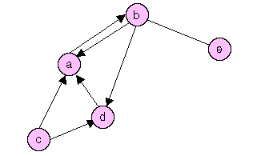
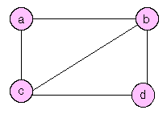
Types of graphs
Undirected Graph: A graph in which the edges have no direction
Edge (1,2) and edge (2,1) are same
Directed Graph(Digraph): A graph in which each edge is directed from one vertex to another vertex.
Edge (1,2) starts from vertex 1 and points to vertex 2
이한출판사

Slide 42
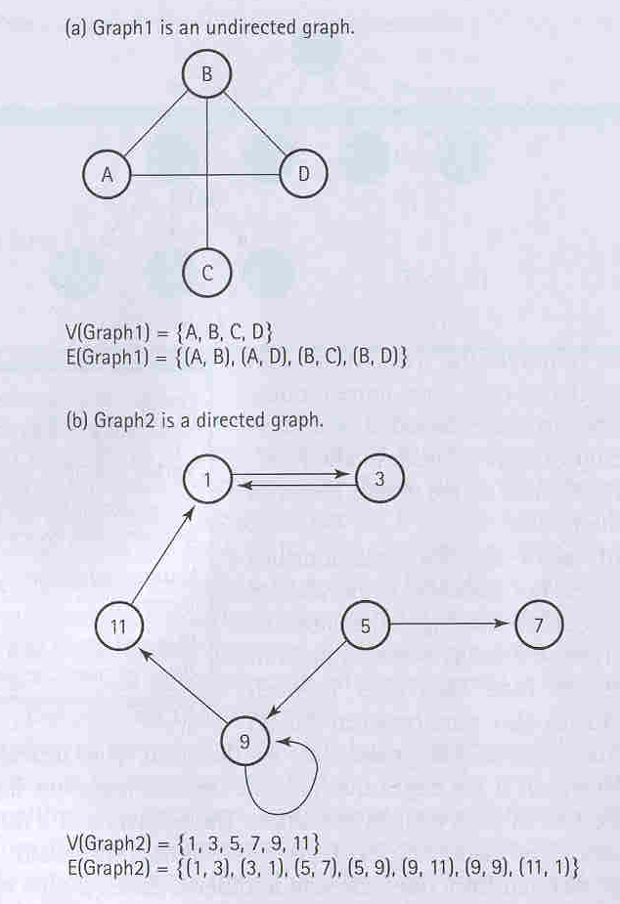
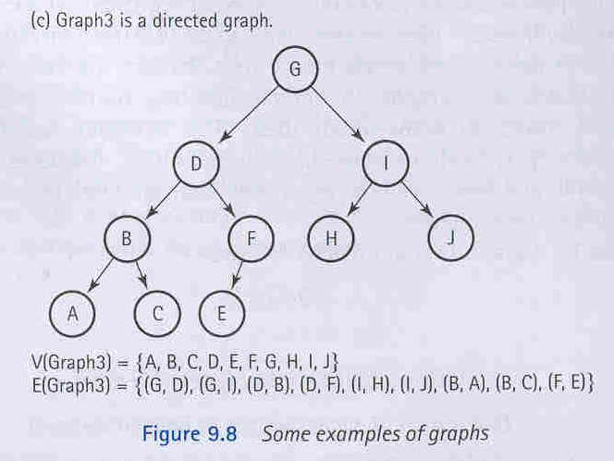
Some Examples

Slide 43
Definition of terminology
Adjacent vertices: Two vertices in a graph that are connected by an edge
Path: A sequence of vertices that connects two nodes in a graph
Complete graph: A graph in which every vertex is directly connected to every other vertex
Weighted Graph: A graph in which each edge carries a value

Slide 44
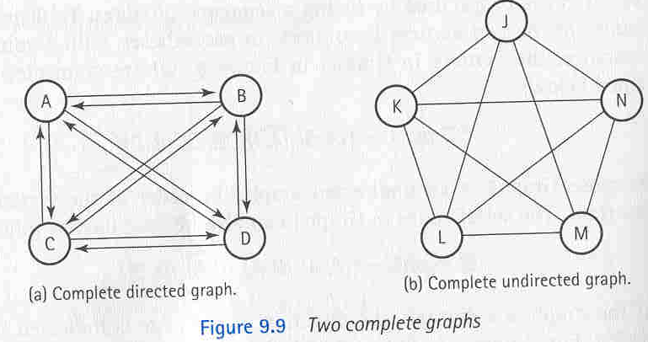
Complete Graph
Number of edges = n(n-1)/2

Slide 45
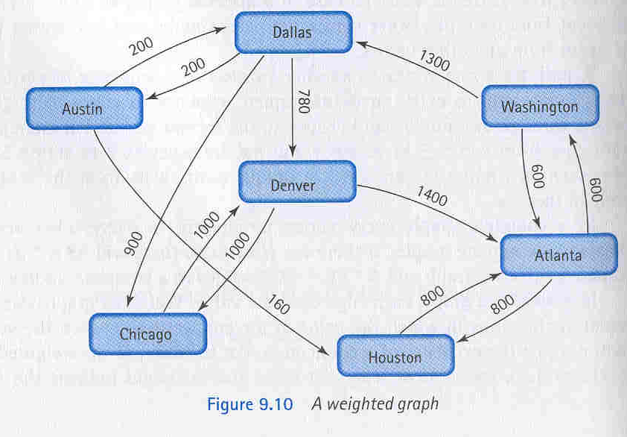
A Weighted Graph

Slide 46
Graph ADT
MakeEmpty
Boolean IsEmpty
Boolean IsFull
AddVertex(VertexType vertex)
AddEdge(VertextType fromVertex, VertexType toVertex, EdgeValueType weight)
EdgeValueType WeightIs(VetexType fromVertex, VertexType toVertex)
GetToVertices(VertexType vertex, QueueType& vertexQ) // returns adjacent vertices in a queue

Slide 47
Depth First Search(깊이 우선 탐색)
Found = False
Stack.Push(startVertex)
Do
stack.Pop(vertex)
if vertex = endVertex
write final vertex
Found = True
else
Write this vertex
Push all adjacent vertices onto stack(방문하지 않은)
While !stack.IsEmpty() AND !Found
If (!found)
Write “Path does not exist”
Depth-First: Post order traversal과 같이 트리의 가장 밑(깊이)까지 내려간 다음 올라오면서 방문.
Breadth-First: 각 정점을 level별로 내려가면서 차례대로 방문

Slide 48
Depth-First: Austin to Washington
Contents of the Stack
At Austin Houston
Dallas
At Houston Atlant
Dallas
At Atlanta Washington
Dallas
At Washington End
Start
End
Mark the vertex visited.
Cycling

Slide 49
Additions to Graph ADT
To avoid revisiting the vertex already visited, use a flag showing the status of visiting.
ClearMark
Function: initialize the flag for all vertices
MarkVertex(VertexType vertex)
Function: set the flag of vertex to True
Boolean IsMarked(VertexType vertex)
Function: return True if vertex is marked

Slide 50
template<class VertexType>
void DepthFirstSearch(GraphType
<VertexType> graph, VertexType
startVertex,VertexType endVertex)
{
using namespace std;
StackType<VertexType> stack;
QueType<VertexType> vertexQ;
bool found = false;
VertexType vertex;
VertexType item;
graph.ClearMarks();
stack.Push(startVertex);
do {
stack.Pop(vertex);
if (vertex == endVertex)
{
cout << vertex);
found = true;
}
else
{
if (!graph.IsMarked(vertex))
{
graph.MarkVertex(vertex);
cout << vertex;
graph.GetToVertices(vertex,
vertexQ);
while (!vertexQ.IsEmpty())
{
vertexQ.Dequeue(item);
if (!graph.IsMarked(item))
stack.Push(item);
}
}
}
} while (!stack.IsEmpty() && !found);
if (!found)
cout << "Path not found." << endl;
}
50

Slide 51
Breadth-First Search(너비우선탐색)
Find all possible paths before move to the next level.
2
Contents of Queue
At Austin Houston, Dallas
At Dallas Denver, Chicago, ,Houston
At Houston Atlanta, Denver
, Chicago
At Chicago Denver, Atlanta
, Denver
At Denver Atlanta, Denver
, Atlanta
At Atlanta Washington, Atlanta
,Denver
Skip Atlanta and Denver
At Washington End
1
7
5
6
4
3

Slide 52
void BreadthFirstSearch(GraphType<VertexType> graph,
VertexType startVertex, VertexType endVertex)
{
using namespace std;
QueType<VertexType> queue;
QueType<VertexType> vertexQ;
bool found = false;
VertexType vertex;
VertexType item;
graph.ClearMarks();
queue.Enqueue(startVertex);
do
{
queue.Dequeue(vertex);
if (vertex == endVertex)
{
cout << vertex;
found = true;
}
else
{
if (!graph.IsMarked(vertex))
{
graph.MarkVertex(vertex);
cout << vertex;
graph.GetToVertices(vertex, vertexQ);
while (!vertexQ.IsEmpty())
{
vertexQ.Dequeue(item);
if (!graph.IsMarked(item))
queue.Enqueue(item);
}
}
}
} while (!queue.IsEmpty() && !found);
if (!found)
cout << "Path not found." << endl;
}
52

Slide 53
Single-Source Shortest-Path Problem
Many paths may exist between two vertices
Want to find the shortest path among the paths.
Ex) Shortest path between Austin and Washington by Korean Airline
Possible paths between Austin and Washington
Austin → Houston → Atlanta → Washington
(160) + (800) + (600) = 1560
Austin→Dallas→Denver→Atlanta→Washington
(200) + (780) + (1400) + (600) = 1980
Shortest-Path Search
Use Priority Queue instead of queue in breadth first search algorithm. Take the vertex with minimum edge weight.

Slide 54
ShortestPath(graph,startVertex)
graph.ClearMarks()
item.fromVertex = startVertex
item.toVerex = startVertex
item.distance = 0
pq.Enqueue(item)
do
pq.Dequeue(item)
if item.toVertex is not Marked
Mark item.fromVertex
Write item
item.fromVertex=item.toVertex
minDistance = item.distance
Item.fromVertex에 인접한 vertex 들을 담은 Queue(vq)를 생성
while !vq.Empty()
vq.Dequeue(vertex)
if !graph.IsMarkted(vertex)
item.toVertex = vertex
item.distance = minDistance
+graph.WeightIs(fromVertex , vertex)
pq.Enqueue(item)
while !pq.IsEmpty()
Use min. heap for the Queue
Continue until all the vertices are visited.

Slide 55
ShortestPath(graph,Washington)
pQ: {(7,7,0)}
1. Washington Washington 0
vQ:{2(1300),6(600)}, mD=0
pQ: {(7,2,1300), (7,6,600)}
2. Washington Atlanta 600
vQ:{3(800)}, mD=600
pQ: {(6,3,1400),(7,2,1300)}
3. Washington Dallas 1300
vQ:{4(900),5(780),1(200)}, mD=1300
pQ: {(2,4,2200),(2,1,1500), (6,3,1400) (2,5,2080),}
4. Atlanta Houston 1400
vQ:{}, mD=1400
pQ: {(2,4,2200),(2,5,2080) ,(2,1,1500)}
5. Dallas Austine 1500
6. Dallas Denver 2080
7. Dallas Chicago 2200
2
1
7
5
6
4
3
Find the minimum distance between Washing to and all other cities.

Slide 56
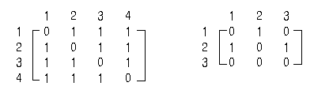
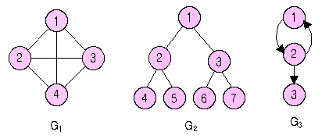
Array Implementation
Present the graph with N vertices by using a NxN Adjacency Matrix
Adjacency Matrix: 2D array showing the connection between any two vertices. If the element (i,j) is 1, vertex i and j are connected. Otherwise, they not connected.
Ex) Adjacency matrix of G1 Adjacency matrix of G3
이한출판사

Slide 57
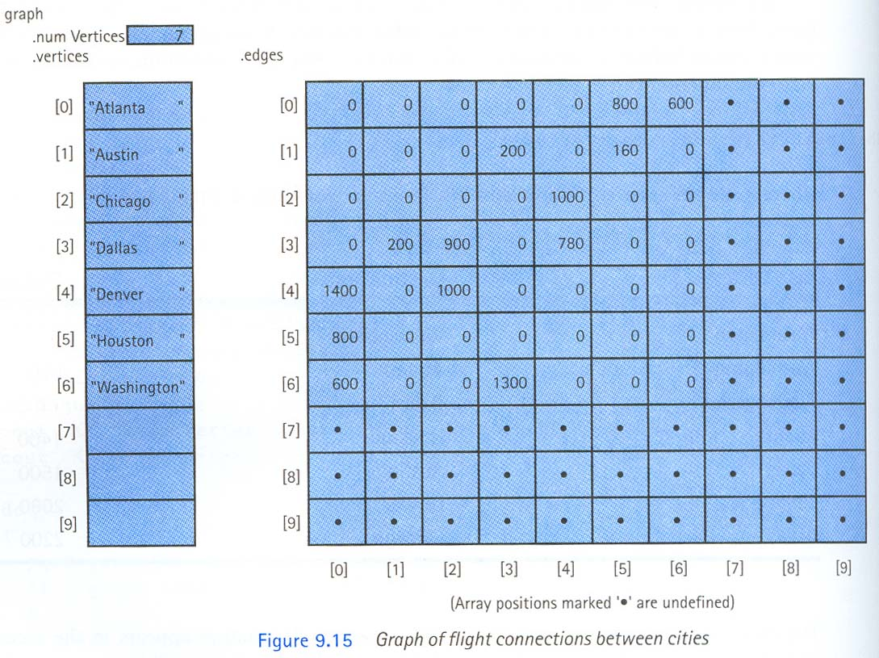
Graph of flight connections between cities

Slide 58
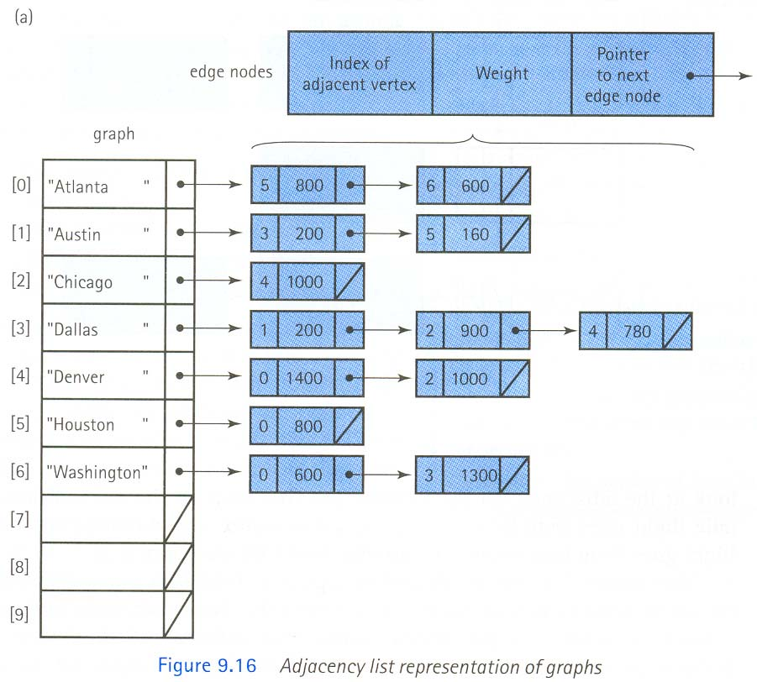
Linked Implementation
Adjacency List: list containing adjacent vertices

Slide 59
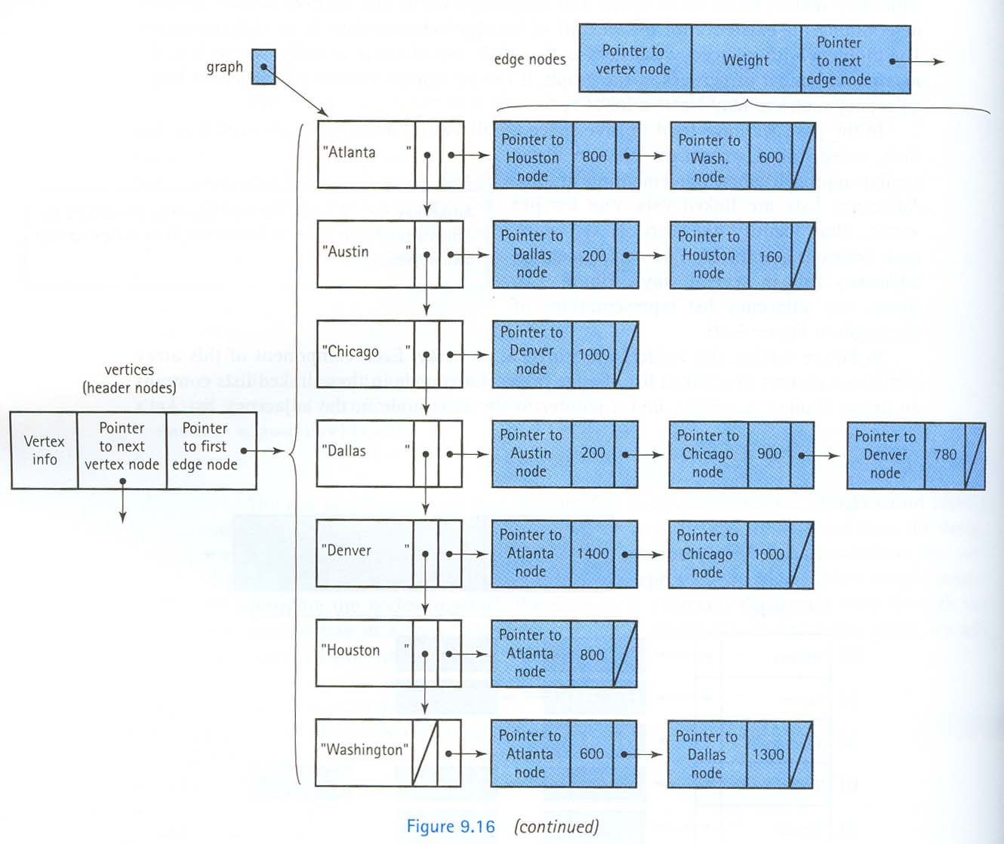
Implementation using linked list only

